Slide 1
  My Schedule, Calendar
LEVEL - PRACTITIONER

Slide 2
About the Author
Created By: | Arpita Bhattacharya, Saibal Roy, Supriyo Saha
Credential Information: | Associate – Projects; Sr. Consultant CRM – EAS Salesforce
Version and Date: | V1: 25-Jan-2018, V1.1: August-2023: Updated with Lightning UI
Modified By: | Abhijan Majumdar

Slide 3
Recap ...
In the previous Module – Address, TSF and Account Merge, you learnt to ...
Define and describe VEEVA Address, its specific fields & type
Identify the objects used to hold a new Address, Territory Specific Fields(TSF), VEEVA managed attributes for TSF and TSF configuration
Merge two or more duplicate accounts using the VEEVA Account Merge functionality in order to maintain proper data
And now ...

Slide 4

Do You Know
My Schedule is a module provided to plan and schedule visits with medical professionals and businesses
A weekly calendar view is provided, and scheduling takes into consideration the user’s current calendar and best times to visit the professionals and businesses
This functionality is integrated with the existing salesforce.com calendar
My Schedule supports the display of Medical Events.
Users see Medical Events in My Schedule if they either
own the Medical Event or are listed as an attendee
(where status is not Rejected)

Slide 5

Overview
VEEVA CRM allows two calendar modules:
  My Schedule
  SFDC Calendar

Slide 6

Objectives
After completing this chapter, you will be able to define:
  Components in My Schedule
    Weekly view
    Monthly view
    Calendar Sharing
    Cycle
  SFDC Calendar

Slide 7
My Schedule

Slide 8
Overview – My Schedule
The My Schedule module displays all the user's activities in agenda, weekly, and monthly views
Users can create and modify activities in My Schedule as well as apply Call Cycles, map daily calls, and view office best times
The agenda view displays activities for each day in a list. Each activity type displays pertinent information about the activity including the color
Visibility of each view within the calendar can be controlled through individual VEEVA custom settings
If Enable New iPad Calendar is enabled but none of the
sub-panels are enabled, the page does not display properly

Slide 9
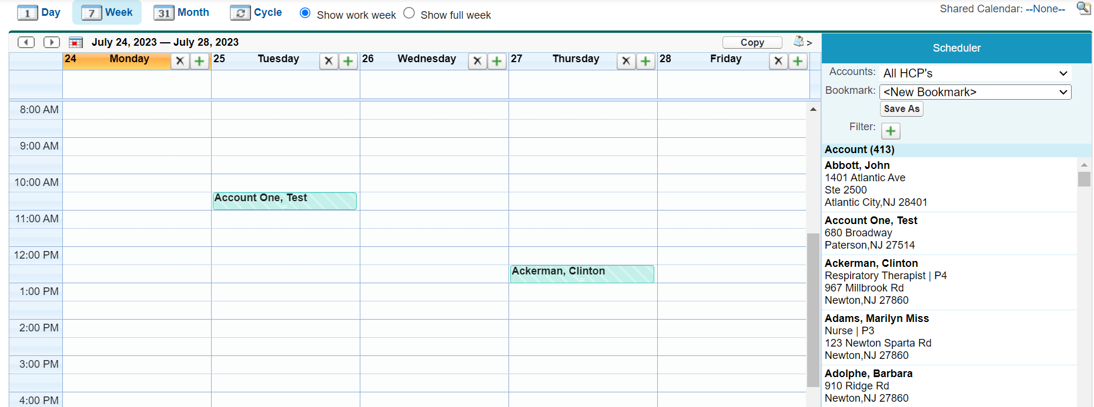
My Schedule.. 1
Contains FOUR Tabs:
  Day - Month
  Week - Cycle

Slide 10
My Schedule.. Configuring Calendar Views
My Schedule
  ENABLE_NEW_CALENDAR_ONLINE custom setting must be set to True to use the VEEVA My Schedule online
  Enable New iPad Calendar custom setting must be set to True to use the VEEVA My Schedule offline on CRM (iRep). Once enabled, enable 1 or more of the following:
    Enable Calendar Agenda View: Users only see calls that they own. Colors for calls are based upon status and date
      Planned: Clear, or custom
      Saved: Teal
      Submitted: Blue
      Planned, but in the past: Red
    Enable Calendar Week View
    Enable Calendar Month View
  Note: Shortcut link to “Calendar” is not the same as My Schedule and is not used in the VEEVA application. If Enable New iPad Calendar is enabled but none of the sub-panels are enabled, the page does not display properly

Slide 11
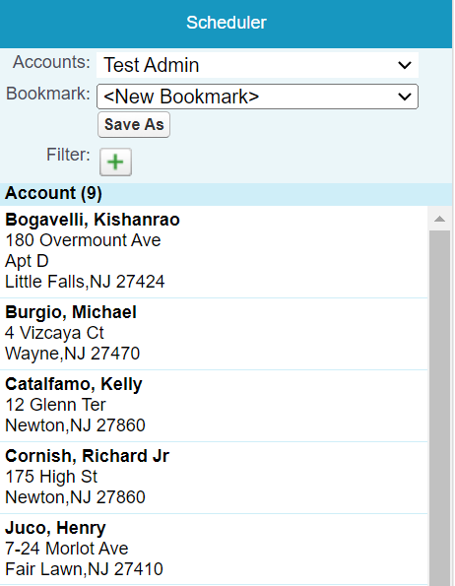
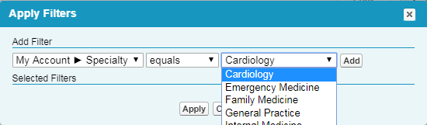
My Schedule.. 2
My Schedule
  Allows users to schedule calls against Accounts from various lists, while viewing their schedule
  Lists available for selection:
    My Accounts Views
    Account Lists
    User’s active or future Cycle Plans
  Users need to drag and drop selected accounts onto the calendar to schedule a call for that account
User can choose different views
User can choose filters

Slide 12
My Schedule - Configuration.. 1
VEEVA admin needs to perform various configuration changes as per need:
  Pre-Call Notes field visibility →
    Use standard field-level security
  Address records may be suppressed →
    Use the Inactive_vod field
  Number of attendees displayed on the day and week views for group calls →
    Set the VEEVA Custom Setting Enable_Group_Call_Attendee_Display to TRUE

Slide 13
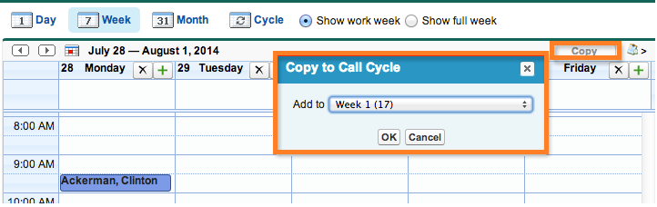
My Schedule - Configuration.. 2
My Schedule
  Users can create a Call Cycle by copying an entire week’s schedule to a call cycle week
  To enable the Copy button:
    Set Enable_Copy_To_Call_Cycle_Button Custom Setting to True
  If not being used the Cycle tab can be hidden by:
    Checking the Disable_Call_Cycle_View_vod field on the Preferences_vod object or
    Removing access to the Call_Cycle_Entry_vod object

Slide 14
My Schedule - List Filters
To define the available filters, populate the SCHEDULER_FILTER_vod Custom Setting with a comma-delimited list of API Field Names:
From these objects, only these types of fields are supported:
  Date, Checkbox, Picklist, and Text
        • Account, Address, or TSF objects
        • [Object Code].[API Field Name]:
        ACC= Account For E.g.,
        ADD= Address ACC.Target__c
        TSF= Territory ADD.Zip_vod__c
        Specific Field TSF.Last_Activity_Date_vod__c

Slide 15
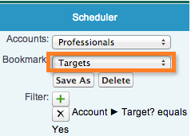
My Schedule - Bookmarks
Users can bookmark previously used search criteria eliminating the need to re-create commonly used search filters
Bookmarks can be created online only and, viewed online and offline
To enable access to Bookmarks-
    Give profiles CRUD(Create-Read-Update-Delete) permission to the Bookmark_vod object
    Give profiles access to all Bookmark_vod record types
    Activate Bookmark_vod__c VMOC record

Slide 16
My Schedule - Monthly View
My Schedule tab includes a monthly view
Reps can view their schedule for a full month, create new calls, and drill into existing calls, events and Time Off Territory records
This feature is on by default and does not require configuration
Available both on the online and offline platforms

Slide 17
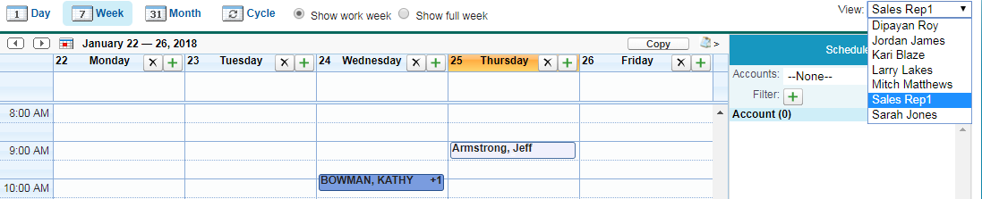
Calendar Sharing
Only available online, allows users to overlay a read-only view of another user’s calendar on top of their own
  Helps users avoid call scheduling conflicts

Slide 18
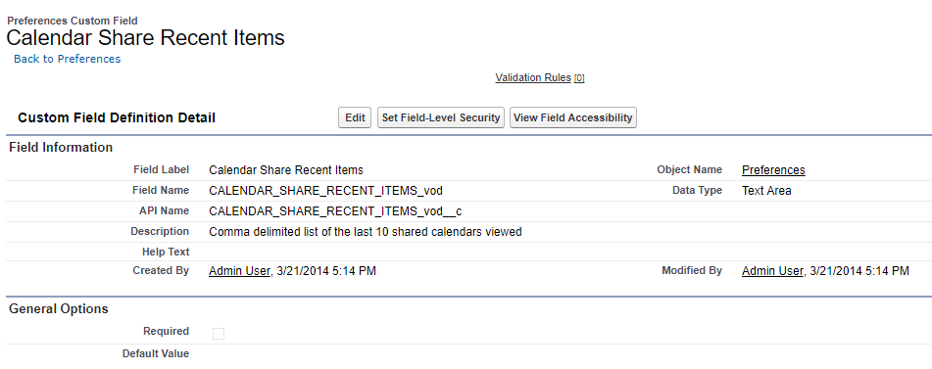
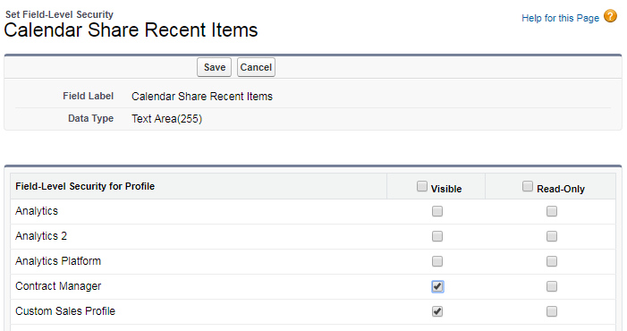
Enable Calendar Sharing
To enable this feature, go to:
  Setup > Create > Objects > Preferences
  Grant user profiles visibility to the Calendar_Share_Recent_Items_vod__c field
  Visibility is controlled through roles or sharing rules for the Activity object

Slide 19
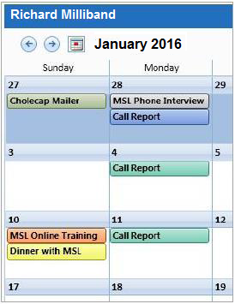
Multi-Channel Calendar.. 1
Provides a 360-degree view of all interactions with an account
Month-at-a-time calendar
Online and Tablet editions
Default colors are used for the various objects; users can change the color coding. Default colors are the following:
  Call
    Submitted - Blue
    Saved - Teal
    Planned Call - Clear
    Past-due Planned Call - Red
  Medical Inquiry - Olive
  Medical Event - Purple
  Sent Email - Yellow
  Event - Orange
  Time Off Territory - Maroon
Click the Calendar button on the Account detail page

Slide 20
Multi-Channel Calendar.. 2
Display various activities like Call, Medical Inquiry, Medical Event, ToT
Load records from external data sources into Salesforce.com Event object
Use Record Types and color coding to quickly determine types of interactions when viewing Multi-Channel Calendar
Record Type name is viewed when hovering over event in Calendar

Slide 21
My Schedule on CRM (iRep)

Slide 22
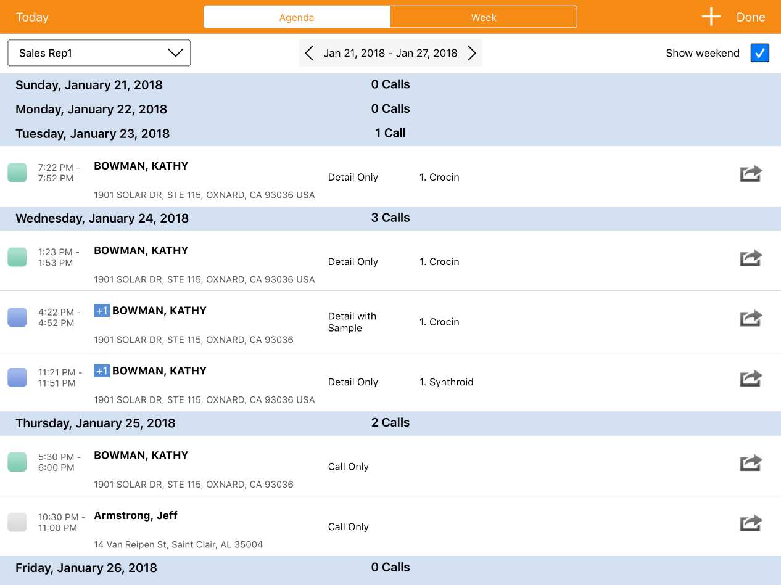
My Schedule on CRM (iRep)
Displays daily or weekly schedule
Users can create:
  New Call, TOT (Time off Territory)
  Calendar Events
Managers can view their employees’ schedule:
  Based on Role hierarchy

Slide 23
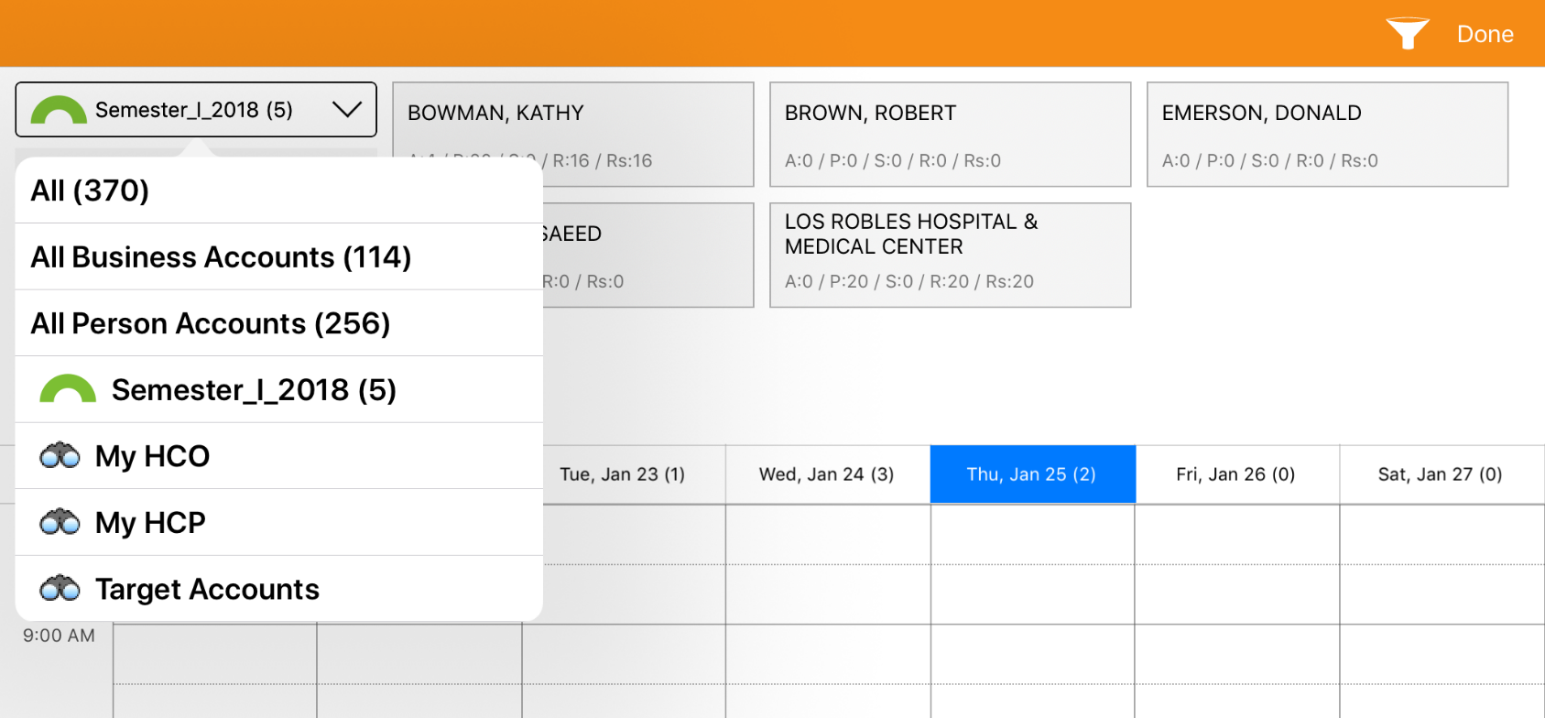
My Schedule - Week Scheduler
Drag-and-drop Accounts in Views, Lists, and Cycle Plans to the weekly scheduler
Makes it easy to find the Accounts to add to the schedule when planning calls
Displays call counts in the day header

Slide 24
My Schedule - External Calendar
To avoid scheduling conflicts, users can view their personal or work iPad calendars in their offline CRM (iRep) calendar
  Set the ENABLE_EXTERNAL_CALENDARS custom setting to True

Slide 25
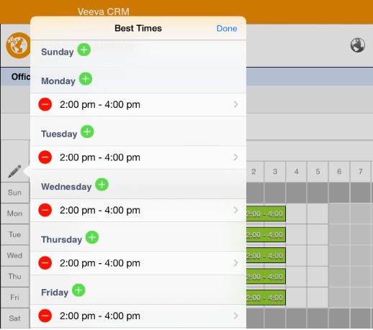
My Schedule - Office Best Times
Users can enter office best times offline on CRM (iRep)
  Navigate to the account and view an address to enter its office best times values

Slide 26
SFDC Calendar

Slide 27
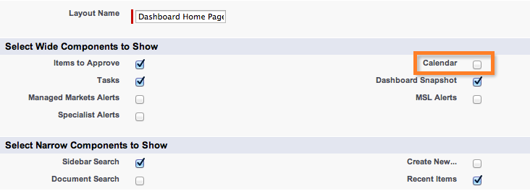
SFDC Calendar
Best practice is not to display the SalesForce.com Calendar, as it typically causes confusion with the VEEVA scheduling functionality (My Schedule)
  Setup > Customize > Home > Home Page Layout
  SHOULD NOT BE ENABLED unless users are using Blackberry Events. Need to watch on latest VEEVA Releases Notes for discontinuation

Slide 28
Best Practices
SFDC Calendar should not be enabled for VEEVA org
Remove the standard SFDC Calendar from Home page layout and left sidebar

Slide 29
Check Your Understanding 1
My Schedule shows which of the following tabs?
Day
Week
Month
Cycle
All of the above
Answer: All of the above
© Cognizant 2023

Slide 30
Check Your Understanding 2
Which custom setting must be set to True to use the VEEVA My Schedule offline on CRM (iRep)?
New iPad Calendar
Enable iPad Calendar
Show iPad Calendar
Enable My Schedule
Answer: New iPad Calendar
© Cognizant 2023

Slide 31

Summary
In this module, you have learnt to,
Describe and configure VEEVA specific functionality :
  My Schedule- Online & Offline
  SFDC Calendar

Slide 32

Source
https://crmhelp.veeva.com/doc/Content/Home.htm
Disclaimer: Parts of the content of this course is based on the materials available from the Web sites and books listed above. The materials that can be accessed from linked sites are not maintained by Cognizant Academy and we are not responsible for the contents thereof. All trademarks, service marks, and trade names in this course are the marks of the respective owner(s).

Slide 33
Coming Next..
In the upcoming module – Products and My Setup you will learn to,
  Define Products Data Model
  Create and Configure Products
  Describe Product Catalog
  Define features in My Setup
  Define Detail Favorites
  Define Detail Topics
  Define Detail Groups
33

Slide 34
Thank you
  You have successfully completed
  My Schedule, Calendar

